Slide 1


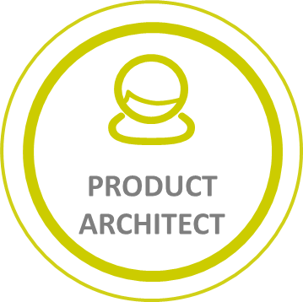




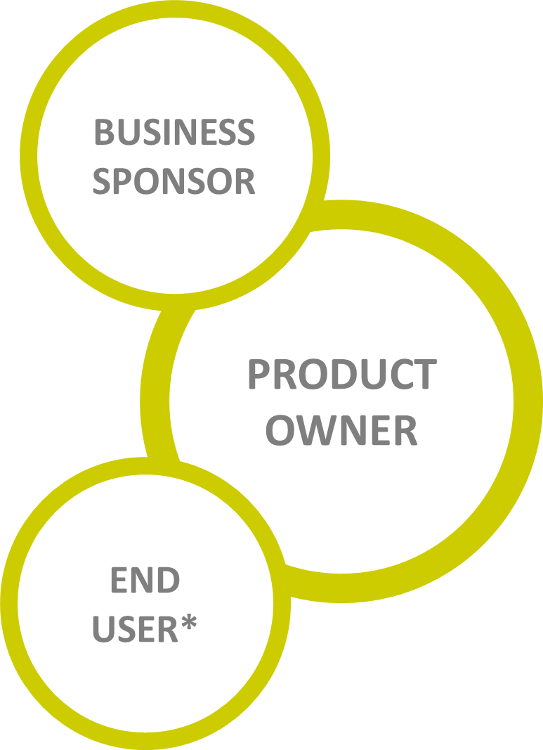


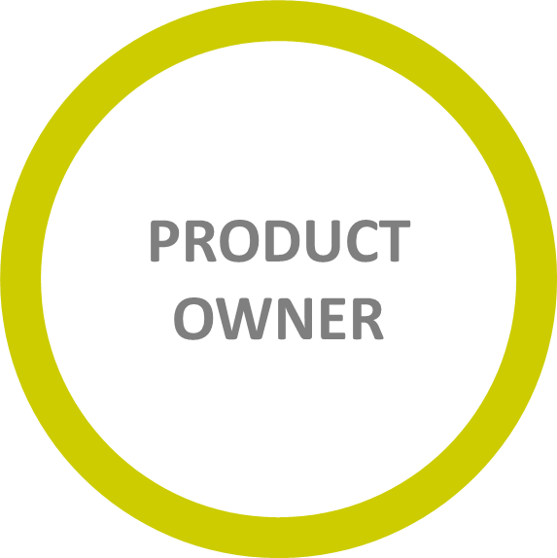
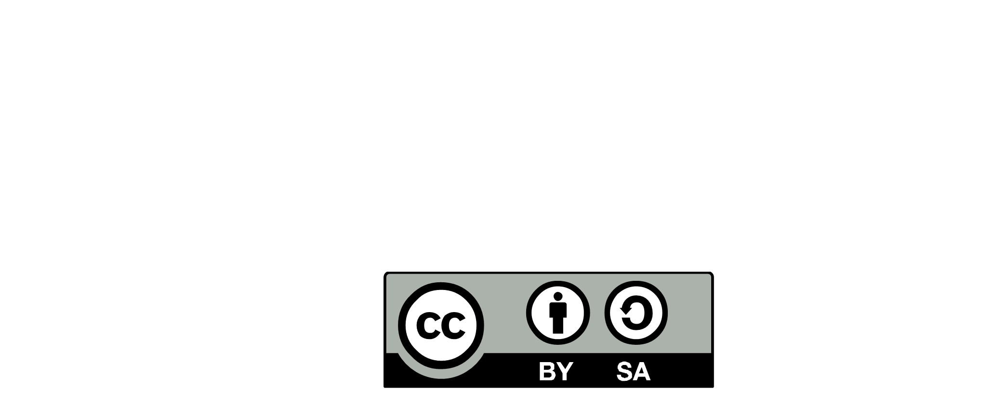

KEY STAKEHOLDERS
Full stack Product Architecture
Building blocks
Autonomy
APPLICATIVE
VIEW
DATA
VIEW
ARCHI
IT PLATFORMS
APPLICATION
PORTFOLIO
ARCHIMATE
PROVIDERS
PHYSICAL
VIEW
Technical architecture
IT platform dialog
Operability
FUNCTIONAL
VIEW
PRODUCT
ARCHITECTURE
TECHNOLOGY
VIEW
Kit
DOMAIN
DRIVEN
DESIGN
KEY STAKEHOLDERS
SYSTEM
CONTEXT
TECHNOLOGY
ARCHITECTURE
Kit
IMPACT
MAPPING
LINKED TO :
PROBLEM
TO
SOLVE
PRODUCT
SCOPING
CUSTOMER
JOURNEY
PRODUCT
BOUNDED
CONTEXT
Kit
Maximize Value for end-user*
Be sure of the problem to solve
Understand the operating model
Kit
PERSONAE
USER
RESEARCH
BUSINESS
ARCHITECTURE
MICHELIN
ARCHITECTURE
CONTINUM
SYSTEM
BOUNDED
CONTEXT
CONTEXT
MAP
INTEGRATION
PATTERN
STRATEGY-
ARCHIteCTURE
RUNWAY
Kit
DOMAIN
DRIVEN
DESIGN
Kit
DOMAIN
DRIVEN
DESIGN
KEY STAKEHOLDERS
UBIGUITUS
LANGUAGE
Kit
VALUE
CHAIN
SYSTEM
ENGINEERING
PROVIDERS/
PRODUCT
DEPENDENCIES
Security
expert
EVENT
STORMING
VALUE
CHAIN
EXPERT
SITE
NUN
FUNCTIONAL
REQUIREMENTS
Kit
EVENT
STORMING
REFERENCE ARCHITECTURE
PRODUCT
ARCHITECTURE
PRINCIPLES
End to end integration
Mutual requirements
Migration strategy
Scale up
Technical debt
PRODUCT
ARCHITECTURE
DRIVERS
PRODUCT
ARCHITECTURE
OVERVIEW
MARKETING
ARCHITECTURE
KEY STAKEHOLDERS
SECURITY
RISK
KEY STAKEHOLDERS
PRODUCT
ROADMAP
Explain and
promote
Simple
For the audience(s)
END USER
PROBLEM
DESCRIPTION
PRODUCT
VISION
ARCHITECTURE
DECISION
OPERABILITY
RISK
Kit
Make the right decision and document it
Rational
Transparence
END USER*
- CLIENT
- BUSINESS
- EMPLOYEE
- PARTNER
IMPACT
MAPPING
BUSINESS
AMIBITIONS
Kit
ARCHITECTURE
DECISION
RECORD
CONTINUOUS ARCHITECTURE DELIVERABLES
-2020.2 -

